Slide 1
EUROPEAN SOCCER Data Analysis
EMSE 6992 – Final Project
Olatunji Akinbule

Slide 2
Questions?
Which attributes contribute most to the overall rating of players?
What insights can be seen from a Player’s speed, age and weight
How do leagues across Europe compare in goal scoring per match?

Slide 3
Dataset Description
Sqlite Database comprising:
10,000 players and 42 Player attributes,
11 countries and leagues,
299 teams

Slide 4
EXPLORATORY DATA ANALYSIS

Slide 5
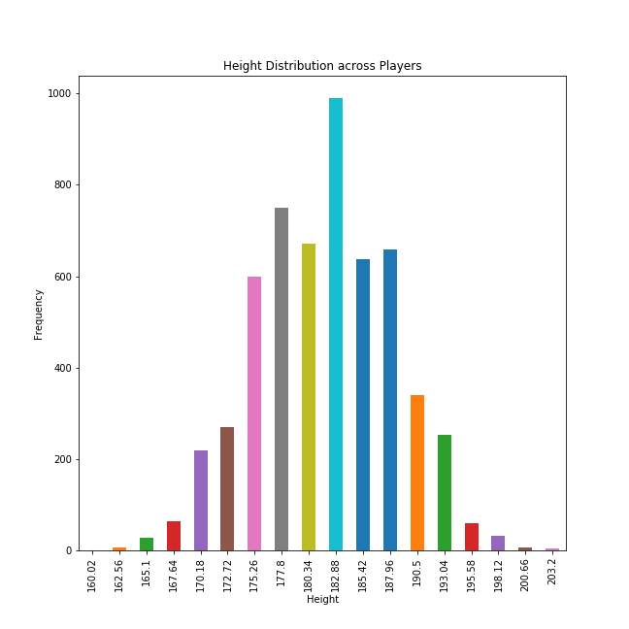
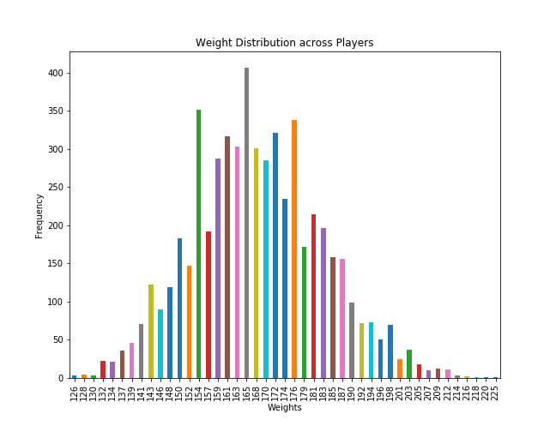
Feature Distributions
Weight Distribution
Height Distribution

Slide 6
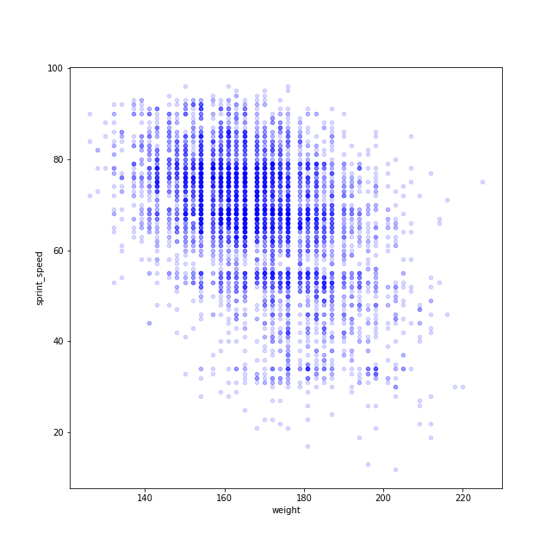
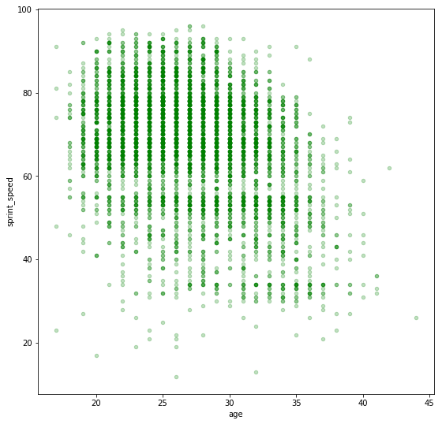
Other Patterns
Player’s top speed begin a steady decline between the range of 26- 28 years
The ideal speed-star will fall between 140 – 160 pounds

Slide 7
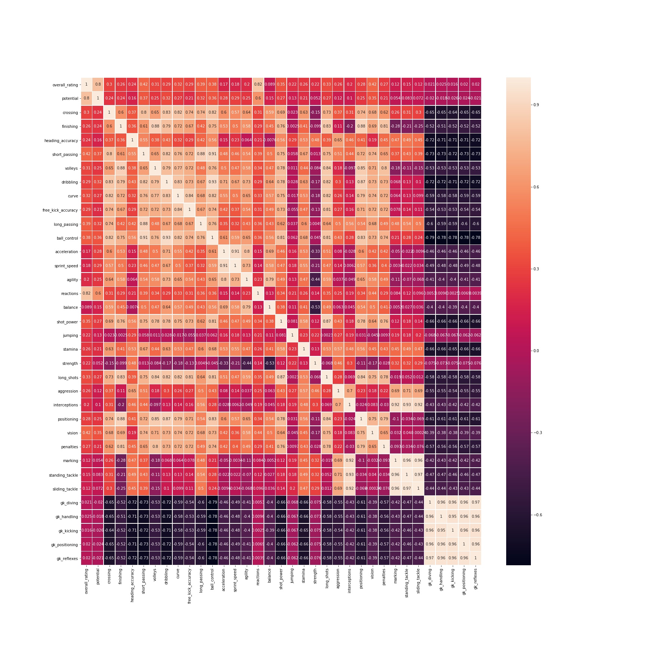
Correlation Analysis

Slide 8
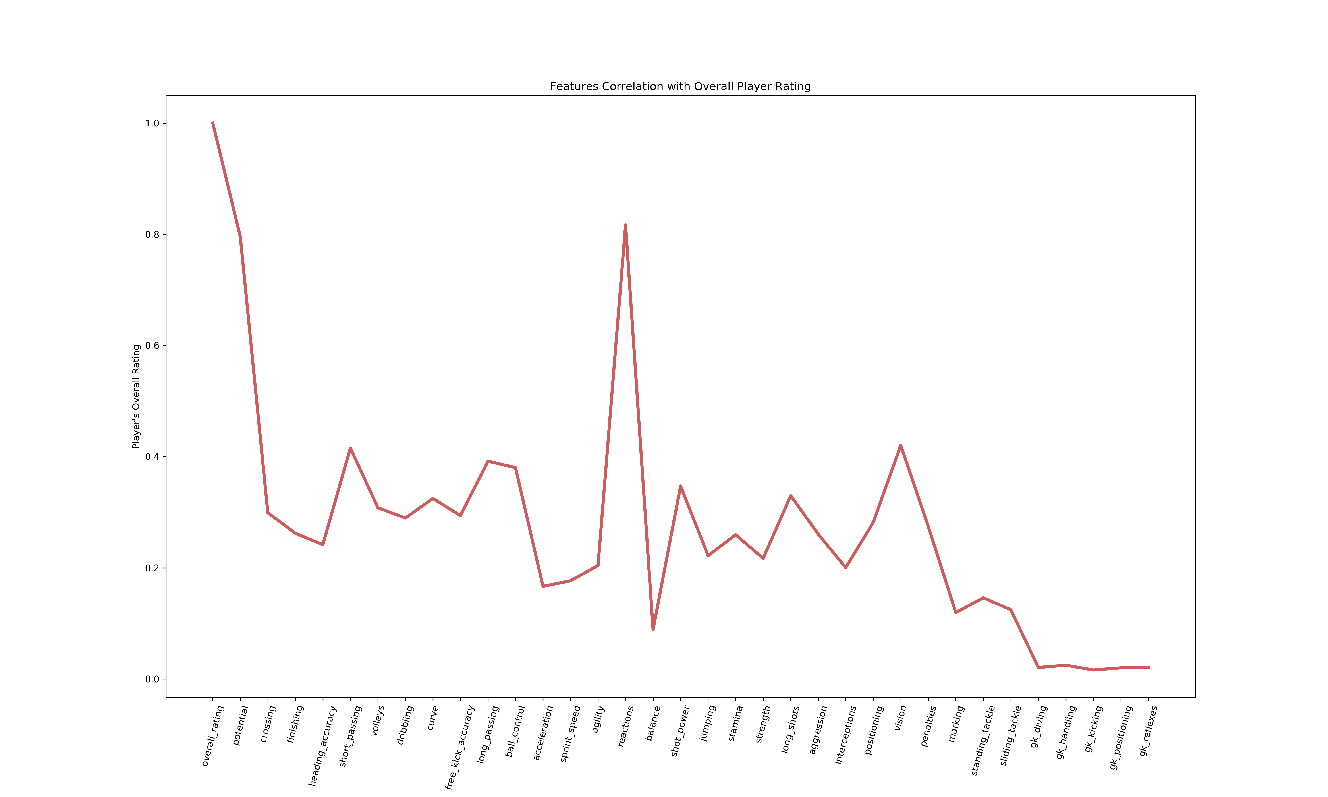
Correlation Analysis

Slide 9
Highest Ranking Features
Reactions (0.817)
Potential (0.795)
Vision (0.420)
Short_Passing(0.415)
Long_Passing(0.392)

Slide 10
PLAYER CLUSTERING (K-MEANS)ON SELECT FEATURES (2006/2007 Season)
Goal-Kick Kicking (launching the ball into the field with a long kick)
Dribbling
Finishing (Scoring Precision)
Interceptions
Standing Tackle

Slide 11
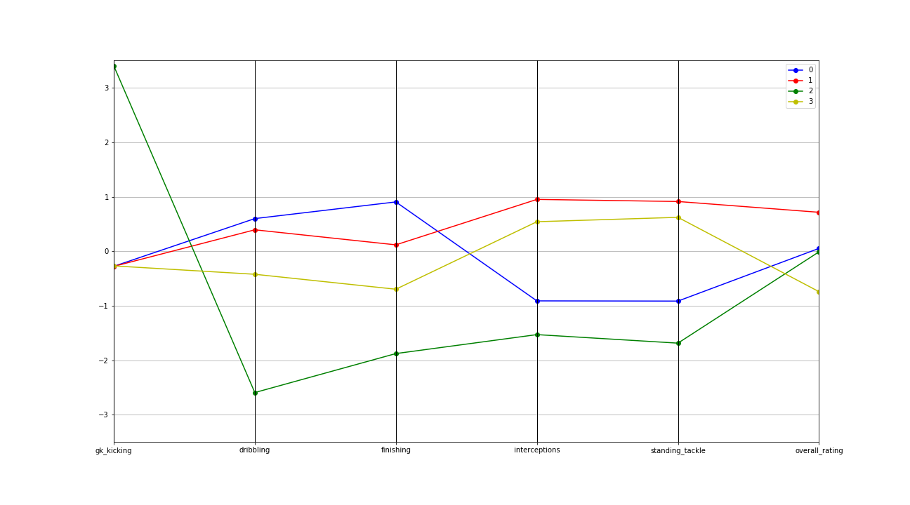
Clustering results Cluster 0 – 1935 players :: Cluster 1 – 1580 players :: Cluster 2 – 417 players :: Cluster 3:: 1654 players

Slide 12
DEDUCTIONS
Goalies (Green) despite their low rankings on selected features have a good rating average. I believe this is because goalies while working as part of a team play a critical individual task of shot stopping with their hands and do not have to perform comparatively well on skills related to using the feet.
Comparing two potential forward groups (Red & Blue). Forwards with higher dribbling and finishing skills (core specializations) are rated lower than Forwards relatively lesser finishing and dribbling skills but show higher Interception and standing tackle abilities

Slide 13
GOAL SCORING PER MATCH (2008/2009 - 2015/2016 Season)
Goal-Kick Kicking (launching the ball into the field with a long kick)
Dribbling
Finishing (Scoring Precision)
Interceptions
Standing Tackle

Slide 14
Goals Per game Comparison for 5 European Leagues

Slide 15
Deductions
The French League had the lowest scoring goal/game ratio across the years
Netherlands Eredwise League had the highest goal/game ratio from 2009/2010 season and onwards
The Spanish LIGA BBVA plateaued at 2.8 goals per game from 2010/2011 till 2012/ 2013 Season

Slide 16
Thank you!

